Slide 1
Graphs in Science

Slide 2

By the end of this Smart Lesson you will be able to:
Name the parts of a graph.
Propose the correct graph to use depending on the data presented.

Slide 3
In science, we draw graphs in a certain way using certain rules. These rules are called conventions.
Some important conventions include:
• | Graph titles
• | Titles for X and Y axes
• | Scientific units

Slide 4
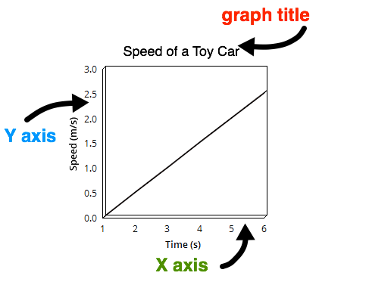
The parts of the graph:
The graph title goes above the graph. This is used to explain what the graph is showing.
The Y axis points straight up and the X axis runs along the page.
We say that the Y axis is vertical and the X axis is horizontal.

Slide 5
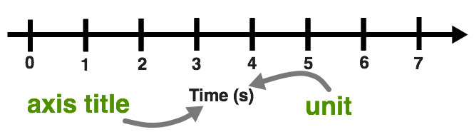
We must choose appropriate titles for our X and Y axes.
This title must clearly describe what is being shown in the graph.
We have numbers running along the axes. This means that the axis title must also include a unit.

Slide 6
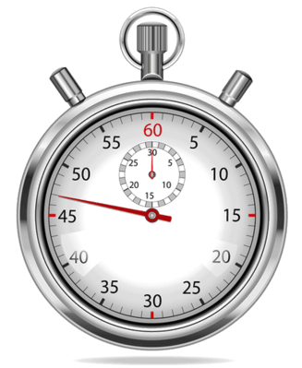
We plot the independent variable on the X axis.
This is the variable which we change or control in the experiment.
An example would be time. Each test you change how long you run the test, and measure the result.

Slide 7
We usually plot the dependent variable on the Y axis.
This is the variable which we measure during the investigation. This variable gives us the information we are trying to find.
Some common examples are distance, speed and force.

Slide 8
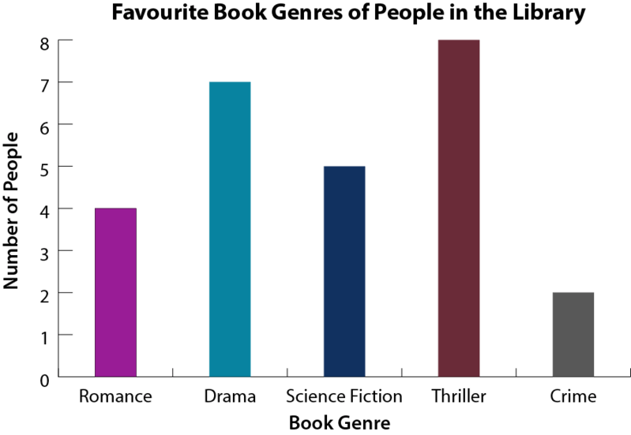
For example, when Marie asks people in the library what their favourite book genres are, she found the following information:
Romance | Drama | Sci-Fi | Thriller | Crime
4 | 7 | 5 | 8 | 2
She transferred the information into the following column graph:

Slide 9
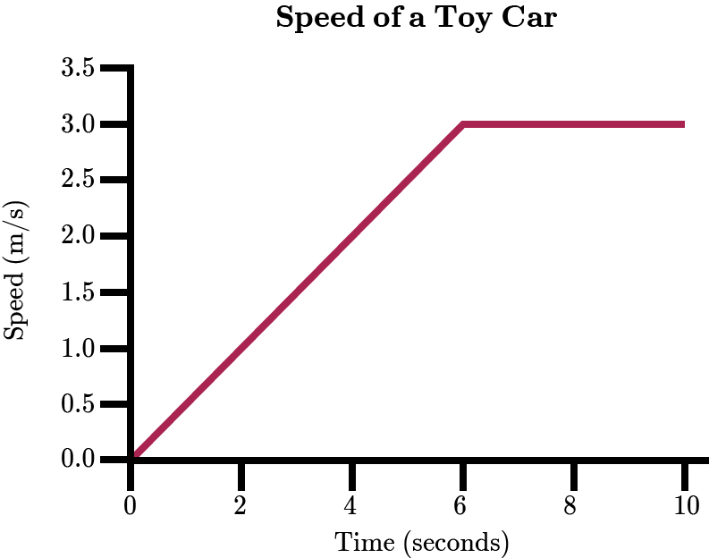
A line graph is useful for quantitative data, such as tracking change over time.
For example, in physics we use line graphs to show the speeds of objects over time.

Slide 10
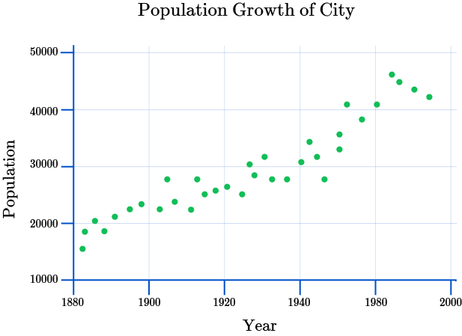
A scatter graph (or scatter plot) is useful when we have a lot of data and want to establish a relationship between two variables.
For example, population is plotted against time in years, giving the scatter graph shown below.

